Slide 1

Project overview:
eQMS implementation plan
Inside, you’ll find detailed instructions to guide you through completing the presentation and effectively communicating the strategic importance of this initiative.

Slide 2

eQMS implementation
Make your case for eQMS:
Embarking on the journey to implement an electronic Quality Management System (eQMS) is a transformative step toward elevating your organization's quality processes. This presentation template is meticulously designed to assist you in articulating the strategic and operational advantages of an eQMS to your executive team, ensuring alignment with organizational goals and securing the necessary buy-in.

Slide 3
eQMS implementation
How to use this template?
Personalize each section: Tailor the content to reflect your organization's specific challenges, objectives, and regulatory environment. Authenticity and relevance are key to resonating with your audience.
Leverage data and case studies: Incorporate concrete data, industry benchmarks, and real-world case studies to substantiate your arguments. This evidence-based approach enhances credibility and persuasiveness.
Anticipate questions: Be prepared to address potential concerns or queries from stakeholders. The notes accompanying each slide offer guidance on key points to cover, ensuring you are well-equipped for discussions.
Emphasize strategic alignment: Highlight how the eQMS implementation aligns with the company's overarching strategic objectives, such as operational efficiency, risk mitigation, and market competitiveness.

Slide 4
eQMS implementation
Executive summary
Problem statement
Our Agenda
Current challenges
Proposed eQMS solution
Strategic value of eQMS
ROI and cost-benefit analysis

Slide 5
eQMS implementation
Comparative analysis of eQMS solutions
Implementation plan and timeline
Our Agenda
Case studies and industry benchmarks
Conclusion
Q&A and next steps
Additional resources

Slide 6

eQMS implementation
Executive summary
Objective: To implement an eQMS solution that enhances the QA department's efficiency, mitigates risks, and supports the organization's overall strategic goals.
Key benefits/Competitive edge: Faster time-to-market and improved product quality enhance customer satisfaction and market positioning.
Cost savings: Reduction in paper/document management expenses, audit preparation costs, and
QA process inefficiencies.
Return of Investment (ROI): Estimated payback period of X months/years.
Initial investment: CAPEX/OPEX breakdown.
Notes:
Begin by providing a succinct overview of the eQMS implementation proposal, emphasizing key benefits such as enhanced compliance, streamlined processes, risk reduction, and accelerated time-to-market. Make sure to align key benefits with organizational goals. For example, implementing an eQMS can lead to a X% reduction in document approval times, thereby speeding up product releases. Mention that the proposal is valid for a specific number of months from the stated date to convey a sense of urgency and timeliness.

Slide 7
eQMS implementation
Value summary
Increase operational efficiencies
Streamline documentation workflows to reduce administrative overhead by 30% | €00,00
Reduce number of FTE required to manage quality and compliance documentation by 1.0 | €00,00
Automate routine quality processes, cutting manual effort by 15% | €00,00
Reduce number of QA FTE time spent on mandatory training by 75% | €00,00
Mitigate risk
Reduce time to set up a QMS by 75% | €00,00
Reduce time spent preparing for quality audits by 50% | €00,00
Cut the time required to address audit findings by 25% | €00,00
Grow/Protect revenue
Accelerate time to market by 30% | €00,00
Reduce costs associated with product recalls or compliance penalties | €00,00
TOTAL VALUE OVER 3 YEARS | €00,00
Notes:
Begin by providing a succinct overview of the eQMS implementation proposal, emphasizing key benefits such as enhanced compliance, streamlined processes, risk reduction, and accelerated time-to-market. Make sure to align key benefits with organizational goals. For example, implementing an eQMS can lead to a X% reduction in document approval times, thereby speeding up product releases. Mention that the proposal is valid for a specific number of months from the stated date to convey a sense of urgency and timeliness.

Slide 8
eQMS implementation
Problem statement
How to complete the following slide
Outline the current situation and conduct a need assessment.
Paint a vivid picture of current challenges, making the cost of inaction impossible to ignore. Ensure they are data-driven and aligned with the C-suite’s priorities.
Reference 1: The hidden costs of not having an eQMS
Reference 2: eQMS adoption opportunity vs. hidden Costs of Inaction (CoI)
Reference 3: How to conduct a software needs assessment
Notes:
Outline the current pain points. Paint a vivid picture of current challenges, making the cost of inaction impossible to ignore. Ensure they are data-driven and aligned with the C-suite’s priorities.
Consequences of inaction:
Dedicate a small section to highlight what’s at stake if the problem is not addressed.
Example:
Increased risk of regulatory fines.
Missed opportunities for operational efficiency and growth.
Higher costs due to inefficiencies and rework.

Slide 9
eQMS implementation
Problem statement
Consequences of inaction:
Increased risk of regulatory non-compliance and fines.
Missed opportunities for operational efficiency and growth.
Higher costs due to inefficiencies and rework.
Scalability limitations during business expansion.
Data security vulnerabilities.
Manual processes lead to inefficiencies, consuming 30% more time than automated systems.
Notes:
Outline the current pain points. Paint a vivid picture of current challenges, making the cost of inaction impossible to ignore. Ensure they are data-driven and aligned with the C-suite’s priorities.
Consequences of inaction:
Dedicate a small section to highlight what’s at stake if the problem is not addressed.
Example:
Increased risk of regulatory fines.
Missed opportunities for operational efficiency and growth.
Higher costs due to inefficiencies and rework.
Scalability limitations with business expansion.
Data security risks.

Slide 10
eQMS implementation
Business need:
Current challenges
How to complete the following slide
This slide should highlight the key pain points and challenges faced by the QA department. The goal is to provide context for why implementing an eQMS is critical. Focus on data-driven insights and strategic impacts to resonate with the audience.
Notes:
In this section, it's crucial to provide concrete examples highlighting the organization's current quality management challenges.
List key challenges: Identify 3-5 specific issues that the QA team faces. Use clear, concise language. Each point should address a critical pain area.
Examples include:
Inefficiencies: Our current manual document handling process requires quality staff to spend approximately five (5) hours per week searching for and organizing paper documents. This delays project timelines and increases the likelihood of errors due to misfiled or outdated documents.
Compliance gaps: During the last internal audit, we identified 15 instances where standard operating procedures (SOPs) were not followed correctly, leading to minor non-conformances. These inconsistencies stem from a lack of standardized processes and insufficient training documentation.
Risk exposure: In the past year, we experienced two product recalls due to issues traceable to inadequate documentation and oversight. These incidents affected customer trust and resulted in financial losses totaling €XXX,000.

Slide 11

eQMS implementation
Business need:
Current challenges
1
Inefficiencies in manual and paper-based QA processes.
2
Compliance gaps and inconsistent processes result in audit findings.
3
Lack of traceability increases the risk of product recalls.
Notes:
In this section, it's crucial to provide concrete examples highlighting the organization's current quality management challenges.
List key challenges: Identify 3-5 specific issues that the QA team faces. Use clear, concise language. Each point should address a critical pain area.
Examples include:
Inefficiencies: Our current manual document handling process requires quality staff to spend approximately five (5) hours per week searching for and organizing paper documents. This delays project timelines and increases the likelihood of errors due to misfiled or outdated documents.
Compliance gaps: During the last internal audit, we identified 15 instances where standard operating procedures (SOPs) were not followed correctly, leading to minor non-conformances. These inconsistencies stem from a lack of standardized processes and insufficient training documentation.
Risk exposure: In the past year, we experienced two product recalls due to issues traceable to inadequate documentation and oversight. These incidents affected customer trust and resulted in financial losses totaling €XXX,000.

Slide 12
eQMS implementation
Proposed eQMS solution
How to complete the following slide
Overview: Briefly describe the eQMS, focusing on its purpose: automating and centralizing quality processes to improve efficiency and compliance.
Addressing challenges: Highlight key challenges the eQMS will resolve, such as reducing manual errors, ensuring compliance, enhancing traceability, and lowering costs.
Notes:
Describe the eQMS solution in detail, focusing on how it addresses the previously mentioned challenges. For example:
Solution overview: The proposed eQMS will digitize all quality management processes, providing a centralized platform for document control, training management, and audit trails.
Addressing challenges: The eQMS will reduce manual errors, ensure compliance, and enhance traceability while boosting productivity and reducing the overall cost of quality/non-quality. By automating document workflows, the eQMS will eliminate manual errors and reduce document retrieval times by 50%. Its compliance management features will ensure adherence to regulatory standards, decreasing non-conformance risk. Enhanced traceability will quickly identify issues, mitigating product recall risk.
Key features: User-friendly interface, scalability, and seamless integration with existing systems.The eQMS offers an intuitive user interface that requires minimal training, supports scalability to accommodate company growth, and integrates seamlessly with existing enterprise systems like ERP and CRM platforms.
Expected outcome: Implementation of an eQMS software designed to automate quality management processes, ensure real-time data visibility and tracking, enhance collaboration and harmonization across departments, simplify compliance with regulatory standards (FDA, ISO, etc.), etc.
By detailing these aspects, you can demonstrate how the eQMS is tailored to the organization's specific quality management challenges.

Slide 13
eQMS implementation
Proposed eQMS solution
Overview The proposed eQMS will digitize all quality management processes, providing a centralized platform for document control, training management, and audit trails. This initiative aims to streamline operations, reduce risks, and align quality management with the organization’s strategic objectives.
Addressing challenges Improves operational efficiency by reducing manual tasks. Enhances compliance readiness, minimizing audit risks. Increases collaboration across departments. Provides better decision-making through real-time insights. Enhanced traceability will quickly identify issues, mitigating product recall risk.
Notes:
Describe the eQMS solution in detail, focusing on how it addresses the previously mentioned challenges. For example:
Solution overview: The proposed eQMS will digitize all quality management processes, providing a centralized platform for document control, training management, and audit trails.
Addressing challenges: The eQMS will reduce manual errors, ensure compliance, and enhance traceability while boosting productivity and reducing the overall cost of quality/non-quality. By automating document workflows, the eQMS will eliminate manual errors and reduce document retrieval times by 50%. Its compliance management features will ensure adherence to regulatory standards, decreasing non-conformance risk. Enhanced traceability will quickly identify issues, mitigating product recall risk.
Key features: User-friendly interface, scalability, and seamless integration with existing systems.The eQMS offers an intuitive user interface that requires minimal training, supports scalability to accommodate company growth, and integrates seamlessly with existing enterprise systems like ERP and CRM platforms.
Expected outcome: Implementation of an eQMS software designed to automate quality management processes, ensure real-time data visibility and tracking, enhance collaboration and harmonization across departments, simplify compliance with regulatory standards (FDA, ISO, etc.), etc.
By detailing these aspects, you can demonstrate how the eQMS is tailored to the organization's specific quality management challenges.

Slide 14
eQMS implementation
Proposed eQMS solution
How to complete the following slide
Key features: List essential features like user-friendly design, scalability, and seamless integration, explaining their importance for meeting organizational needs.
Expected outcome: Summarize the benefits, such as streamlined operations, reduced risks, and alignment with strategic goals, emphasizing measurable improvements.
Notes:
Describe the eQMS solution in detail, focusing on how it addresses the previously mentioned challenges. For example:
Solution overview: The proposed eQMS will digitize all quality management processes, providing a centralized platform for document control, training management, and audit trails.
Addressing challenges: The eQMS will reduce manual errors, ensure compliance, and enhance traceability while boosting productivity and reducing the overall cost of quality/non-quality. By automating document workflows, the eQMS will eliminate manual errors and reduce document retrieval times by 50%. Its compliance management features will ensure adherence to regulatory standards, decreasing non-conformance risk. Enhanced traceability will quickly identify issues, mitigating product recall risk.
Key features: User-friendly interface, scalability, and seamless integration with existing systems.The eQMS offers an intuitive user interface that requires minimal training, supports scalability to accommodate company growth, and integrates seamlessly with existing enterprise systems like ERP and CRM platforms.
Expected outcome: Implementation of an eQMS software designed to automate quality management processes, ensure real-time data visibility and tracking, enhance collaboration and harmonization across departments, simplify compliance with regulatory standards (FDA, ISO, etc.), etc.
By detailing these aspects, you can demonstrate how the eQMS is tailored to the organization's specific quality management challenges.

Slide 15
eQMS implementation
Proposed eQMS solution
Key features Automated workflows for CAPA, change control, and trainings. Real-time data tracking and analytics for quality insights. Integration with existing systems (e.g., ERP, LIMS, CRM).
Expected outcome Increase cross-departmental collaboration efficiency by XX%, measured by reduced response times and task completion rates, within 6 months of eQMS adoption. Achieve XX% user adoption of the eQMS system across all relevant departments within 3 months of system deployment, as measured by user activity logs and training completion rates. Achieve a XX% reduction in manual quality management tasks within 9 months.
Notes:
Describe the eQMS solution in detail, focusing on how it addresses the previously mentioned challenges. For example:
Solution overview: The proposed eQMS will digitize all quality management processes, providing a centralized platform for document control, training management, and audit trails.
Addressing challenges: The eQMS will reduce manual errors, ensure compliance, and enhance traceability while boosting productivity and reducing the overall cost of quality/non-quality. By automating document workflows, the eQMS will eliminate manual errors and reduce document retrieval times by 50%. Its compliance management features will ensure adherence to regulatory standards, decreasing non-conformance risk. Enhanced traceability will quickly identify issues, mitigating product recall risk.
Key features: User-friendly interface, scalability, and seamless integration with existing systems.The eQMS offers an intuitive user interface that requires minimal training, supports scalability to accommodate company growth, and integrates seamlessly with existing enterprise systems like ERP and CRM platforms.
Expected outcome: Implementation of an eQMS software designed to automate quality management processes, ensure real-time data visibility and tracking, enhance collaboration and harmonization across departments, simplify compliance with regulatory standards (FDA, ISO, etc.), etc.
By detailing these aspects, you can demonstrate how the eQMS is tailored to the organization's specific quality management challenges.

Slide 16
eQMS implementation
Strategic value of eQMS for [Company Name]
How to complete the following slide
Articulate the strategic benefits of implementing an eQMS, such as scalability, cost-efficiency, and maintaining a competitive edge through enhanced quality management. Strengthen the connection between the eQMS implementation and the company's overall strategic goals.
Notes:
Articulate the strategic benefits of implementing an eQMS, such as scalability, cost-efficiency, and maintaining a competitive edge through enhanced quality management. Strengthen the connection between the eQMS implementation and the company's overall strategic goals. For instance, include a "Strategic Alignment" table that explicitly links eQMS benefits to key performance indicators (KPIs) and long-term business objectives. Align these benefits with the company's long-term goals. For example:
Scalability: The eQMS can grow with the company, accommodating future expansions and evolving regulatory requirements.
Cost-efficiency: Potential cost savings through process automation and reduced error rates.
Competitive advantage: Improved quality management enhances competitiveness, such as faster product releases and higher customer satisfaction.
By aligning the eQMS implementation with strategic objectives, you can underscore its value proposition to upper management.

Slide 17
eQMS implementation
Strategic value of eQMS for [Company Name]
Scalability: As [Company Name] plans to expand into new markets, the eQMS can easily adapt to increased production volumes and diverse regulatory landscapes, ensuring consistent quality management across all operations.
Cost-efficiency: Automating quality processes is projected to reduce operational costs by XX% over the next two years by minimizing manual labor and decreasing the incidence of costly errors.
Competitive advantage: With streamlined quality management, [Company Name] can accelerate product development cycles, enabling faster time- to-market and enhancing customer satisfaction through reliable product quality.
Notes:
Articulate the strategic benefits of implementing an eQMS, such as scalability, cost-efficiency, and maintaining a competitive edge through enhanced quality management. Strengthen the connection between the eQMS implementation and the company's overall strategic goals. For instance, include a "Strategic Alignment" table that explicitly links eQMS benefits to key performance indicators (KPIs) and long-term business objectives. Align these benefits with the company's long-term goals. For example:
Scalability: The eQMS can grow with the company, accommodating future expansions and evolving regulatory requirements.
Cost-efficiency: Potential cost savings through process automation and reduced error rates.
Competitive advantage: Improved quality management enhances competitiveness, such as faster product releases and higher customer satisfaction.
By aligning the eQMS implementation with strategic objectives, you can underscore its value proposition to upper management.

Slide 18
eQMS implementation
Return of Investment (ROI) and cost-benefit analysis
How to complete the following slide
Financial projections: Projected costs and savings over a defined period, including implementation expenses and anticipated reductions in quality-related costs.
Expected ROI: Calculating return on investment based on projections, highlighting the timeframe for achieving positive returns.
Cost-benefit breakdown: Detailed comparison of costs versus anticipated benefits, such as labor savings, reduced compliance penalties, and improved product quality. Add detailed breakdowns of anticipated savings using tables or graphs.
Notes:
Provide a detailed financial analysis, including initial investment, ongoing costs, and quantifiable benefits. Utilize tools like Scilife’s ROI Calculator to estimate potential savings and benefits. For example:
Financial projections: The initial implementation cost of the eQMS is estimated at €XXX,000, with annual maintenance fees of €XX,000. However, we anticipate annual savings of €XX,000 by reducing manual labor and error-related costs.
Expected ROI: Based on these projections, the eQMS is expected to pay for itself within two years, achieving a positive ROI by the third year.
Cost-benefit breakdown: Beyond direct financial savings, the eQMS will reduce the risk of compliance penalties, which have averaged €XX,000 annually, and improve product quality, leading to an estimated XX% increase in customer satisfaction scores.
By presenting a comprehensive cost-benefit analysis, you can demonstrate the tangible financial advantages of the eQMS implementation.

Slide 19
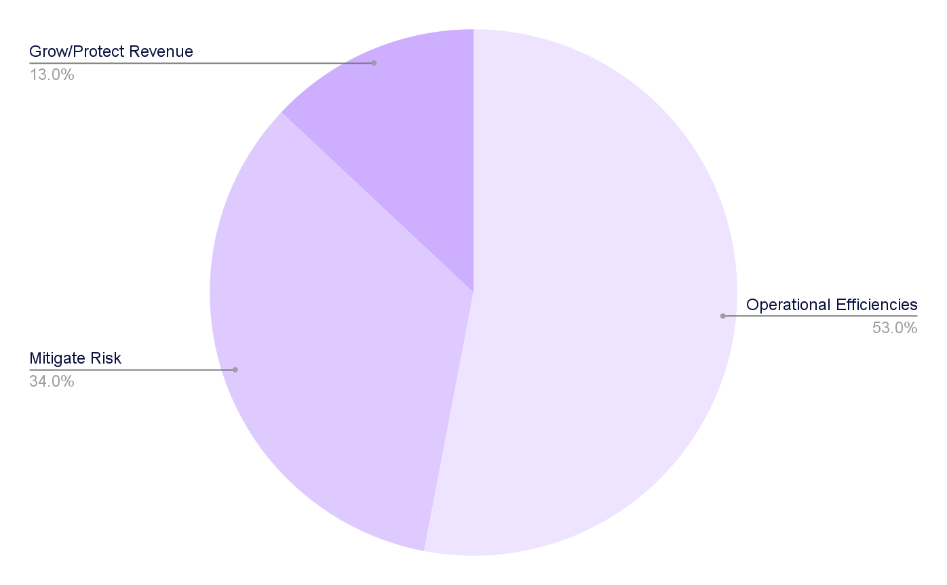
eQMS implementation
Return of Investment (ROI) and cost-benefit analysis
Overall 3 year value created:
€00,00
How Scilife can help you:
Notes:
Provide a detailed financial analysis, including initial investment, ongoing costs, and quantifiable benefits. Utilize tools like Scilife’s ROI Calculator to estimate potential savings and benefits. For example:
Financial projections: The initial implementation cost of the eQMS is estimated at €XXX,000, with annual maintenance fees of €XX,000. However, we anticipate annual savings of €XX,000 by reducing manual labor and error-related costs.
Expected ROI: Based on these projections, the eQMS is expected to pay for itself within two years, achieving a positive ROI by the third year.
Cost-benefit breakdown: Beyond direct financial savings, the eQMS will reduce the risk of compliance penalties, which have averaged €XX,000 annually, and improve product quality, leading to an estimated XX% increase in customer satisfaction scores.
By presenting a comprehensive cost-benefit analysis, you can demonstrate the tangible financial advantages of the eQMS implementation.

Slide 20
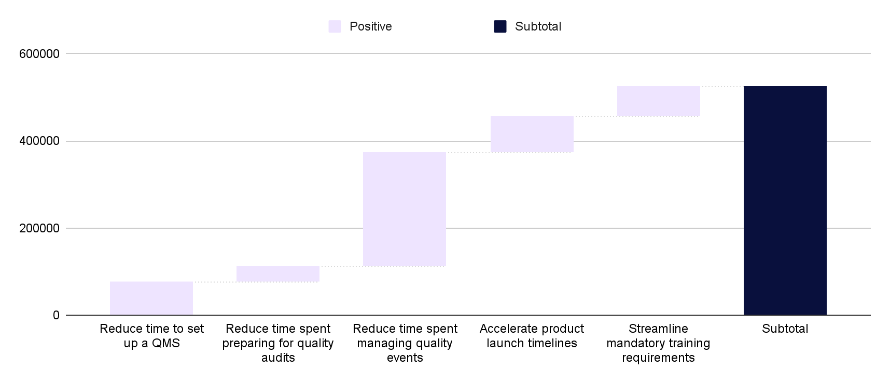
eQMS implementation
Return of Investment (ROI) and cost-benefit analysis
Business value delivered by eQMS
Notes:
Provide a detailed financial analysis, including initial investment, ongoing costs, and quantifiable benefits. Utilize tools like Scilife’s ROI Calculator to estimate potential savings and benefits. For example:
Financial projections: The initial implementation cost of the eQMS is estimated at €XXX,000, with annual maintenance fees of €XX,000. However, we anticipate annual savings of €XX,000 by reducing manual labor and error-related costs.
Expected ROI: Based on these projections, the eQMS is expected to pay for itself within two years, achieving a positive ROI by the third year.
Cost-benefit breakdown: Beyond direct financial savings, the eQMS will reduce the risk of compliance penalties, which have averaged €XX,000 annually, and improve product quality, leading to an estimated XX% increase in customer satisfaction scores.
By presenting a comprehensive cost-benefit analysis, you can demonstrate the tangible financial advantages of the eQMS implementation.

Slide 21
eQMS implementation
Return of Investment (ROI) and cost-benefit analysis
Your current process:
Key quality management activities | Hours to complete / year | Total cost
Document management | €00,00 | €00,00
Training management | €00,00 | €00,00
Event management | €00,00 | €00,00
Audit management | €00,00 | €00,00
Total time & costs | €00,00 | €00,00
Notes:
Provide a detailed financial analysis, including initial investment, ongoing costs, and quantifiable benefits. Utilize tools like Scilife’s ROI Calculator to estimate potential savings and benefits. For example:
Financial projections: The initial implementation cost of the eQMS is estimated at €XXX,000, with annual maintenance fees of €XX,000. However, we anticipate annual savings of €XX,000 by reducing manual labor and error-related costs.
Expected ROI: Based on these projections, the eQMS is expected to pay for itself within two years, achieving a positive ROI by the third year.
Cost-benefit breakdown: Beyond direct financial savings, the eQMS will reduce the risk of compliance penalties, which have averaged €XX,000 annually, and improve product quality, leading to an estimated XX% increase in customer satisfaction scores.
By presenting a comprehensive cost-benefit analysis, you can demonstrate the tangible financial advantages of the eQMS implementation.

Slide 22
eQMS implementation
Return of Investment (ROI) and cost-benefit analysis
With the implementation of an eQMS
Key quality management activities | Hours to complete / year | Total cost
Document management | €00,00 | €00,00
Training management | €00,00 | €00,00
Event management | €00,00 | €00,00
Audit management | €00,00 | €00,00
Total time & costs | €00,00 | €00,00
Notes:
Provide a detailed financial analysis, including initial investment, ongoing costs, and quantifiable benefits. Utilize tools like Scilife’s ROI Calculator to estimate potential savings and benefits. For example:
Financial projections: The initial implementation cost of the eQMS is estimated at €XXX,000, with annual maintenance fees of €XX,000. However, we anticipate annual savings of €XX,000 by reducing manual labor and error-related costs.
Expected ROI: Based on these projections, the eQMS is expected to pay for itself within two years, achieving a positive ROI by the third year.
Cost-benefit breakdown: Beyond direct financial savings, the eQMS will reduce the risk of compliance penalties, which have averaged €XX,000 annually, and improve product quality, leading to an estimated XX% increase in customer satisfaction scores.
By presenting a comprehensive cost-benefit analysis, you can demonstrate the tangible financial advantages of the eQMS implementation.

Slide 23
eQMS implementation
Return of Investment (ROI) and cost-benefit analysis
€
€
€
Total implementation cost
Total saving per year
Expected ROI
€
€
hrs.
Costs of storage
Costs of printing
Hours locating documents
Calculate your custom ROI here
Notes:
Provide a detailed financial analysis, including initial investment, ongoing costs, and quantifiable benefits. Utilize tools like Scilife’s ROI Calculator to estimate potential savings and benefits. For example:
Financial projections: The initial implementation cost of the eQMS is estimated at €XXX,000, with annual maintenance fees of €XX,000. However, we anticipate annual savings of €XX,000 by reducing manual labor and error-related costs.
Expected ROI: Based on these projections, the eQMS is expected to pay for itself within two years, achieving a positive ROI by the third year.
Cost-benefit breakdown: Beyond direct financial savings, the eQMS will reduce the risk of compliance penalties, which have averaged €XX,000 annually, and improve product quality, leading to an estimated XX% increase in customer satisfaction scores.
By presenting a comprehensive cost-benefit analysis, you can demonstrate the tangible financial advantages of the eQMS implementation.

Slide 24
eQMS implementation
Comparative analysis of eQMS solutions
How to complete the following slide
Overview
Core Features
Scalability
Strengths and Weaknesses
Implementation Time
Cost (Estimated)
…
Notes:
This format provides a clear, apples-to-apples comparison that allows the C-suite to quickly understand the trade-offs and align on the best choice. The focus should be on decision-making criteria that resonate with the C-suite, such as cost, functionality, scalability, compliance support, and ROI.

Slide 25
eQMS implementation
Comparative analysis of eQMS solutions
 | Scilife | Solution B | Solution C
Overview | Established provider; widely used in life sciences | New entrant; focused on SMEs | Mid-tier provider with solid reputation
Core Features | Comprehensive eQMS, CAPA, audit, training, document control, more | Document control, quality events, training management | Advanced reporting, document control
Scalability | Suited for life sciences companies of all sizes | Ideal for small to mid-sized companies | Flexible, grows with organizational needs
Strengths | Structured workflows, intuitive interface | Cost-effective, fast deployment | Integrates with most third-party software
Weaknesses | Lacks flexibility for modules or features | Limited scalability | Limited integrations
Cost (Estimated) | Tiered pricing with scalable options | €€ (premium pricing for advanced features) | €€€ (Mid-range pricing)
Notes:
This format provides a clear, apples-to-apples comparison that allows the C-suite to quickly understand the trade-offs and align on the best choice. The focus should be on decision-making criteria that resonate with the C-suite, such as cost, functionality, scalability, compliance support, and ROI.

Slide 26
eQMS implementation
Implementation plan and timeline
How to complete the following slide
Timeline: X months from procurement to go-live.
Phased implementation: Outline the stages of eQMS implementation, from planning to full deployment.
Key milestones: Identify critical milestones and their timelines, such as system configuration, pilot testing, and staff training.
Resource allocation: Clearly outline the resources required for each phase, including budget, internal QA champions, IT support, and vendor-provided training. Specify resources and roles with details such as "IT support: X hours/week" or "Vendor-provided training: X sessions.
Notes:
Present a clear implementation roadmap with phases, timelines, and resource requirements. Ensure executives understand the structured approach to deploying the eQMS and the support needed for successful implementation. For example:
Phased implementation: The implementation will occur in three phases:
Phase 1: System Configuration and Data Migration (Months 1-2)
Phase 2: Pilot Testing in the Quality Control Department (Months 3-4)
Phase 3: Company-Wide Deployment and Training (Months 5-6)
Key milestones:
Completion of system configuration by the end of Month 2
Successful pilot testing and feedback collection by the end of Month 4
Full deployment and staff training completion by the end of Month 6
Resource allocation:
Assign a dedicated project manager and a cross-functional team from IT, Quality Assurance, and Operations.
Allocate a budget of €XXX,000 for software licensing, training, and support services.
By detailing this structured plan, you can demonstrate a clear path to successful eQMS implementation, ensuring all stakeholders know their roles and the project's timeline.

Slide 27
eQMS implementation
Implementation plan and timeline
1
Onboarding and Data Migration
2
Pilot Testing in the Quality Assurance Department
3
Company-Wide Deployment and Training
Start Date/Duration (Months)
Start Date/Duration (Months)
Start Date/Duration (Months)
Enter notes
Enter notes
Enter notes
Key milestones
Key milestones
Key milestones
Required resources
Required resources
Required resources
Notes:
Present a clear implementation roadmap with phases, timelines, and resource requirements. Ensure executives understand the structured approach to deploying the eQMS and the support needed for successful implementation. For example:
Phased implementation: The implementation will occur in three phases:
Phase 1: System Configuration and Data Migration (Months 1-2)
Phase 2: Pilot Testing in the Quality Assurance Department (Months 3-4)
Phase 3: Company-Wide Deployment and Training (Months 5-6)
Key milestones:
Completion of system configuration by the end of Month 2
Successful pilot testing and feedback collection by the end of Month 4
Full deployment and staff training completion by the end of Month 6
Resource allocation:
Assign a dedicated project manager and a cross-functional team from IT, Quality Assurance, and Operations.
Allocate a budget of €XXX,000 for software licensing, training, and support services.
By detailing this structured plan, you can demonstrate a clear path to successful eQMS implementation, ensuring all stakeholders know their roles and the project's timeline.

Slide 28
eQMS implementation
Implementation plan and timeline
Q2 April-May-June | Q3 July-August-Sept | Q4 Oct-Nov-Dec | Q1 Jan-Feb-March | Q2 April-May-June
Onboarding
Pre-Launch / Sandbox Testing
QA Department Evaluation
Deployment and Training
Notes:
This slide outlines the roadmap for implementing the eQMS, detailing key phases, milestones, and timelines. It should provide a clear, actionable plan that assures the audience of a structured and efficient rollout.

Slide 29
eQMS implementation
Case studies and industry benchmarks
How to complete the following slide
Success stories: Share examples of similar companies benefiting from eQMS, including metrics like reduced non-compliance incidents and faster time-to-market.
Industry standards: Discuss benchmarks and standards relevant to eQMS, such as ISO certifications and FDA compliance.
Here you will find a link with relevant case studies.
Notes:
Provide real-world examples and industry benchmarks to substantiate the effectiveness of eQMS solutions. This adds credibility to the proposal and demonstrates proven success. For example:
Success stories:
Company A, a medical device company, achieved ISO 13485 certification with zero non-conformances within six months of implementing an eQMS, expediting their product commercialization.
Company B, a biotech company, achieved audit readiness in X amount of time with a XX% reduction of inconsistencies in audit findings.
Industry standards:
Implementing an eQMS facilitates adherence to ISO 9001 and ISO 13485 standards by providing structured document control and process management.
An eQMS ensures compliance with FDA regulations, such as 21 CFR Part 11, by maintaining secure electronic records and audit trails.
By presenting these case studies and aligning the eQMS implementation with recognized industry standards, you can effectively demonstrate the tangible benefits and necessity of the system.

Slide 30

eQMS implementation
Case studies and industry benchmarks
[Company Name]
Challenge | Approach | Results/Key metrics
Notes:
Provide real-world examples and industry benchmarks to substantiate the effectiveness of eQMS solutions. This adds credibility to the proposal and demonstrates proven success. For example:
Success stories:
Company A, a medical device company, achieved ISO 13485 certification with zero non-conformances within six months of implementing an eQMS, expediting their product commercialization.
Company B, a biotech company, achieved audit readiness in X amount of time with a XX% reduction of inconsistencies in audit findings.
Industry standards:
Implementing an eQMS facilitates adherence to ISO 9001 and ISO 13485 standards by providing structured document control and process management.
An eQMS ensures compliance with FDA regulations, such as 21 CFR Part 11, by maintaining secure electronic records and audit trails.
By presenting these case studies and aligning the eQMS implementation with recognized industry standards, you can effectively demonstrate the tangible benefits and necessity of the system.

Slide 31
eQMS implementation
Conclusion
Summarize the 3-5 key reasons why the selected eQMS should be prioritized.
1
Key reason
2
Key reason
3
Key reason

Slide 32
eQMS implementation
Q&A
Invite questions from the audience to address any concerns or seek clarification.
Notes:
Encourage engagement through a Q&A session.
Questions: Open the floor for questions to clarify any aspects of the proposal, such as implementation specifics, cost details, or expected outcomes.

Slide 33
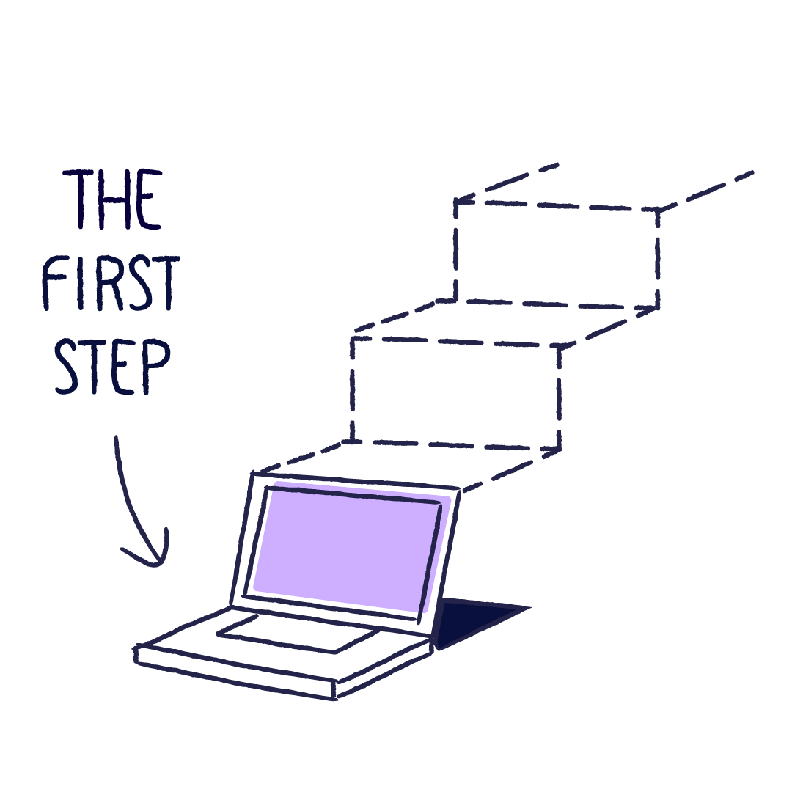
eQMS implementation
Next steps
How to complete the following slide
Action items: List actionable next steps post-approval, such as forming an implementation team and scheduling kickoff meetings.
Decision timeline: Suggest a timeline for decision-making to maintain momentum and ensure timely implementation.
Notes:
Clearly outline the next steps and propose a timeline for moving forward with the eQMS implementation, emphasizing the importance of prompt action. For example:
Action items:
Form a cross-functional implementation team within two weeks of approval.
Schedule a project kickoff meeting within one month to finalize the implementation plan.
Develop a detailed training program for staff to be rolled out in Phase 3.
Decision timeline:
Recommend deciding within four weeks to align with the proposed implementation schedule and promptly capitalize on the projected benefits.
By delineating these steps and timelines, you can foster a sense of urgency and ensure the project progresses smoothly post-approval.

Slide 34
eQMS implementation
Next steps
Action Items
Decisions
Notes:
Clearly outline the next steps and propose a timeline for moving forward with the eQMS implementation, emphasizing the importance of prompt action. For example:
Action items:
Form a cross-functional implementation team within two weeks of approval.
Schedule a project kickoff meeting within one month to finalize the implementation plan.
Develop a detailed training program for staff to be rolled out in Phase 3.
Decision timeline:
Recommend deciding within four weeks to align with the proposed implementation schedule and promptly capitalize on the projected benefits.
By delineating these steps and timelines, you can foster a sense of urgency and ensure the project progresses smoothly post-approval.

Slide 35

eQMS implementation
Additional resources
Scilife ROI Calculator: Include a link to Scilife’s ROI Calculator for personalized savings estimates. (scilife.io)
Industry articles: Provide links to relevant articles, such as 'Business case for an eQMS: how to gain management support.' (scilife.io)
Notes:
Offer additional resources for executives to explore further, reinforcing the proposal's validity and providing tools for deeper analysis. For example:
Scilife ROI Calculator: Utilize this tool to input specific company data and generate personalized ROI estimates, aiding financial decision-making.
Industry articles: Share these articles to provide deeper insights into the strategic importance and financial benefits of implementing an eQMS, helping to build a stronger business case. Include links to additional case studies.
By providing these resources, you empower stakeholders to conduct their own analyses and gain a comprehensive understanding of the eQMS's value proposition.

Slide 36





































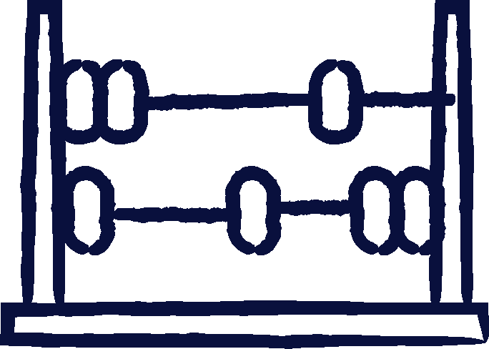




























eQMS implementation
Additional resources
Icons section
Notes:
Offer additional resources for executives to explore further, reinforcing the proposal's validity and providing tools for deeper analysis. For example:
Scilife ROI Calculator: Utilize this tool to input specific company data and generate personalized ROI estimates, aiding financial decision-making.
Industry articles: Share these articles to provide deeper insights into the strategic importance and financial benefits of implementing an eQMS, helping to build a stronger business case. Include links to additional case studies.
By providing these resources, you empower stakeholders to conduct their own analyses and gain a comprehensive understanding of the eQMS's value proposition.

Slide 37
Want to know more?
We’re here to answer all your questions!
EMEA Office
Groenenborgerlaan 16 2610 Antwerpen Belgium
US Office
Scilife Inc.
228 E 45th St. RM 9E New York, NY 10017
scilife.io
Let’s talk >>>

Slide 38


